Slide 1
GOVERNMENT DEGREE COLLEGE WOMEN’S(A)
SRIKAKULAM

Slide 2
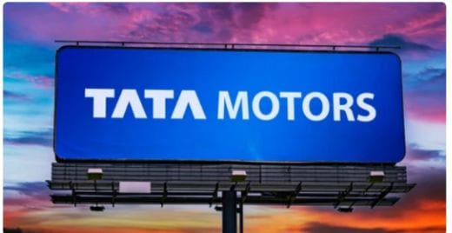

Slide 3
COMPREHENSIVE DIGITAL MARKETING PROJECT WORK ON TATA MOTORS
Team Leader:Vanjyala Syamala
Team Member:Potnuru Rajani
Team Member:Savara Prameela
Team Member:Segalla Nelima
Team Member:Tandela Sravani

Slide 4
References
https://www.instagram.com/tata_motors_1235?igsh=MWt0dHcyMHo2bDljcA==
https://www.instagram.com/p/C57kyw6yU4GfeH41Mtb4pa7MA6C5foxOBvzLCA0/?igsh=NTdhdW9tZzgzcHR4 https://www.instagram.com/stories/tata_motors_1235/3349432475591419211?igsh=MWoycWU1Mmpnbng2Ng==

Slide 5
Report on Tata Motors
Introduction:
Tata motors limited is an Indian Multi National automotive manufacturing company headquartered in Mumbai in Mumbai, Maharashtra, India. It is a part of Tata Group. Its products include passenger cars, trucks, vans, coaches, buses, sports cars, construction equipment and military vehicles.
Tata Motors Group is a currently one of the biggest automakers operating both in India and globally. They are currently changing from the inside of the company by building modern manufacturing facilities to enhance the production efficiency to cut costs when they can and also to embrace the innovation culture. However, there are many challenges ahead of them. Tata Motors Group need to develop a comprehensive solution and execute it seriously to retain and gain market share. Tata Motors is actively investing R&D on new technologies for electric and natural gas vehicles. Auto industry market is rapidly changing with constant moving trends.
Objectives:
To understand brief introduction about the company
To know the products and services offered by Tata Motors to its customers
To understand functional areas of Tata Motors
To find out its Corporate Social Responsibilities
To understand SWOT Analysis
To know safety, health and environmental policies of Tata motors

Slide 6
1.3 Introduction to Automobile Industry:
India became the fourth largest auto market in 2019 displacing Germany with about
3.99 million units sold in the passenger and commercial vehicles categories. India is expected to displace Japan as the third largest auto market by 2021.
The two-wheeler segment dominates the market in terms of volume owing to a growing
middle class and a young population. Moreover, the growing interest of the companies in exploring the rural markets further aided the growth of the sector.
India is also a prominent auto exporter and has strong export growth expectations for the near future. In addition, several initiatives by the Government of India and major automobile players in the Indian market are expected to make India a leader in the two- wheeler and four-wheeler market in the world by 2020.
Automobile industry, the business of producing and selling self-powered vehicles, including passenger cars, trucks, farm equipment, and other commercial vehicles. The large number of people the industry employs has made it a key determinant of economic growth.
The Indian automobile industry includes two wheelers, trucks, cars, buses three wheelers which play a crucial role in growth of the Indian economy. India has emerged as Asia’s fourth largest exporter of automobiles behind Japan, South Korea and Thailand. the economic progress of the industry is the amount of goods and services produced which give the capacity for transportation and boost the sale of vehicles. There is a huge increase in automobile production with a catalyst effect directly increasing the demand for a number of raw materials like steel, rubber, plastics, glass, paint, electronics and services.
Domestic automobiles production increased at 2.36% CAGR between FY16-20 with
26.36 million vehicles being manufactured in the country in FY20. Overall, domestic
automobiles sales increased at 1.29% CAGR between FY16-FY20 with 21.55 million vehicles being sold in FY20.
In order to keep up with the growing demand, several auto makers have started
investing heavily in various segments of the industry during the last few months. The industry has attracted Foreign Direct Investment (FDI) worth US$ 24.53 billion between April 2000 and June 2020, according to the data released by Department for Promotion of Industry and Internal Trade.

Slide 7

2.1 Introduction:
Tata Motors Group (Tata Motors) is a $35 billion organisation. It is a leading global automobile manufacturing company. Its diverse portfolio includes an extensive range of cars, sports utility vehicles, trucks, buses and defence vehicles. Tata Motors is one of India's largest OEMs offering an extensive range of integrated, smart and e-mobility solutions
Tata group founded by Jamsetji Tata in 1868, Tata Motors is among the world’s leading
manufacturers of automobiles. Tata believe in ‘Connecting aspirations’, by offering innovative mobility solutions that are in line with customers' aspirations. They are India's largest automobile manufacturer, and they continue to take the lead in shaping the Indian commercial vehicle landscape, with the introduction of leading-edge powertrains and electric solutions packaged for power performances and user comfort at the lowest life-cycle costs. There new passenger cars and utility vehicles are based on impact design and offer a superior blend of performance, driveability and connectivity.
There focus on connecting aspirations and our pipeline of tech-enabled products keeps us at the forefront of the market. We have identified six key mobility drivers that will lead us into the future – modular architecture, complexity reduction in manufacturing, connected & autonomous vehicles, clean drivelines, shared mobility, and low total cost of ownership
There mission - across our globally dispersed organisation – is to be passionate in
anticipating and providing the best vehicles and experiences that excite our global customers.

Slide 8
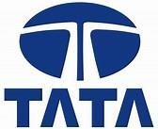
Industry | Auto Mobile Industry
Founder | Jehangir Ratanji Dadabhoy Tata
Established Date | 1945
Tagline | Connecting Aspirations’
Headquarter | Mumbai, Maharashtra, India
Products | Automobiles, Luxury Vehicles, Commercial Vehicles, Automotive Parts, Pickup Trucks
Total asset | ₹322,121.26 crore (US$45 billion) (2020)
Revenue | ₹264,041 crore (US$37 billion) (2020)
Logo of Tata Motors:
Tagline of Tata Motors:
Connecting Aspirations
Vision:
By FY 2024, we will become the most aspirational Indian auto brand, consistently winning, by
Delivering superior financial returns
Driving sustainable mobility solutions
Exceeding customer expectations, and
Creating a highly engaged work force
Mission:
We innovate mobility solutions with passion to enhance the quality of life

Slide 9
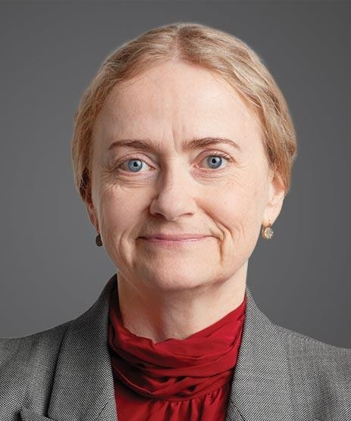
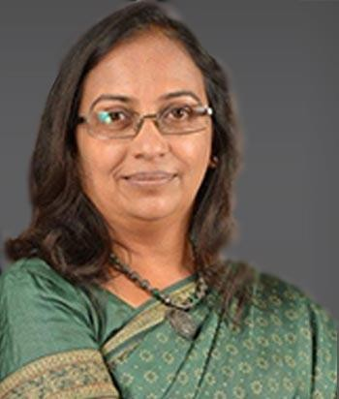
Values:
Integrity
Teamwork
Accountability
Customer focus
Excellence
Speed
2.3 Number of Employees:
78,906 (Employees as of 2020)

Slide 10
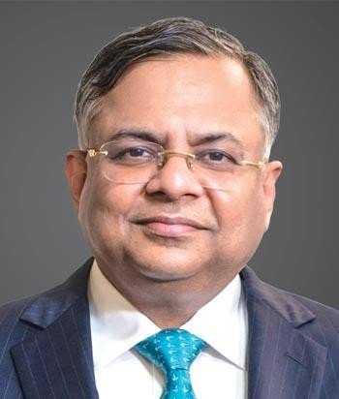
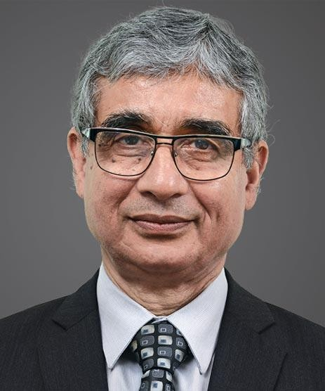
2.4 Board Members: Mr. N Chandrasekaran
Mr. O P Bhatt
Non-Executive Director and
Chairman
Non-Executive, Independent Director
Ms. Hanne Sorensen
Non-Executive, Independent Director
Ms. Vedika Bhandarkar Non-Executive, Independent Director

Slide 11
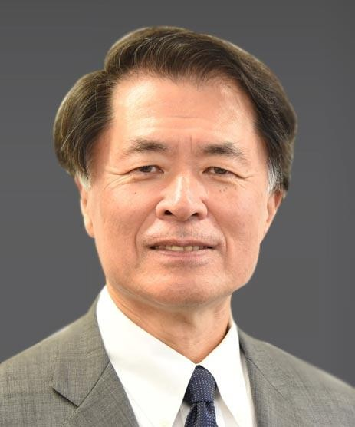
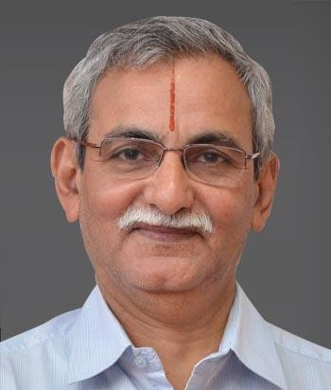
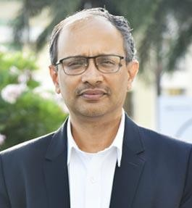
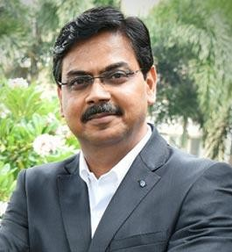
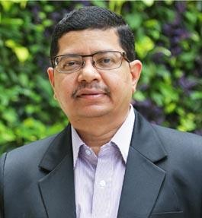
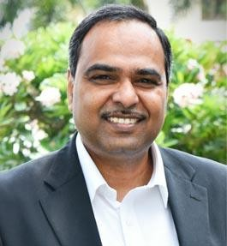
Mr. Mitsuhiko Yamashita Mr. Kosaraju Veerayya Chowdar
Non-Executive, Non-Independent Director Non-Executive, Independent Director
2.5 Management Directors:
Mr. P B Balaji Chief Financial Officer
Mr. Girish Wagh President- Commercial Vehicle
Mr. Shailesh Chandra President - Passenger Vehicles
Mr. Shailesh Chandra President - Passenger Vehicles

Slide 12
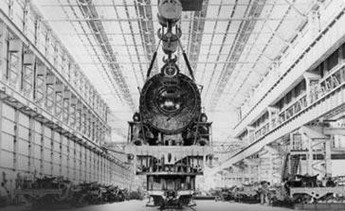
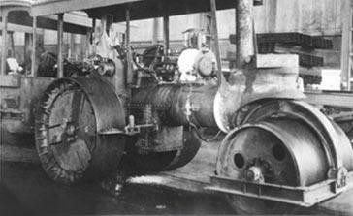
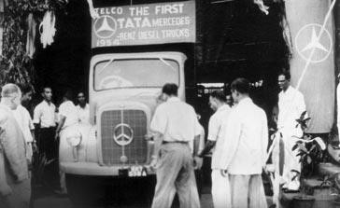
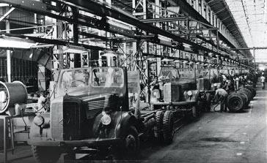
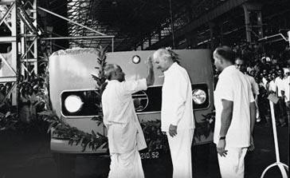
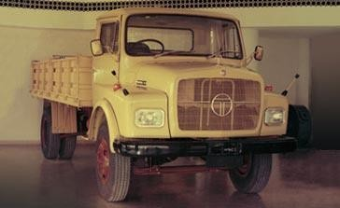
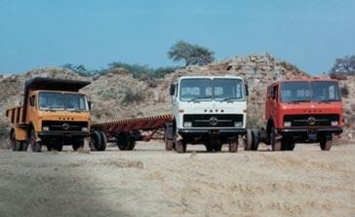
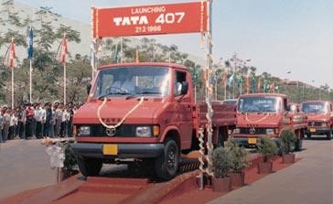
2.6 History of Tata Motors/ Products offered:
Steam Road Roller – 1948 engineering
Manufacturing of locomotives and other products - 1945
Commercial Vehicle – 1954
1210 Series of vehicles - 1964
Telco – 1969
Tata 1210 Semi Forward Model - 1975
Heavy Commercial Vehicles – 1983
Tata LCV 407 - 1986

Slide 13
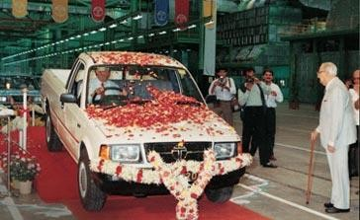
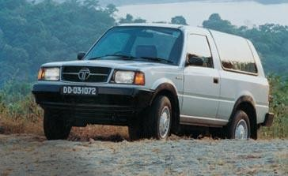
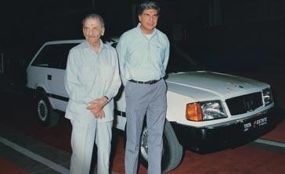
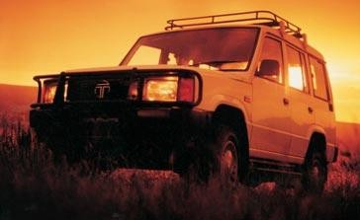
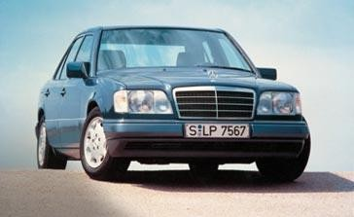
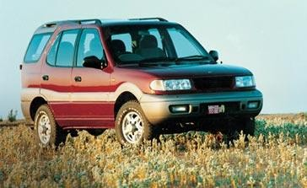
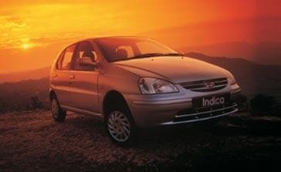
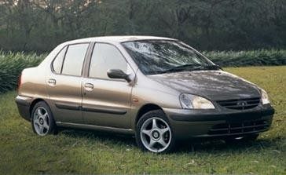
Multi Utility Tata Mobile – 1989 Sierra - 1991
Indigenous Passenger Vehicle Tata
Tata Estate – 1992
Tata Sumo - 1992
Telco – 1995
Tata Safari - 1998
Tata Indica – 1998
Tata Indigo - 2002

Slide 14
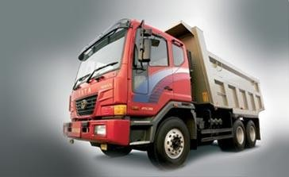
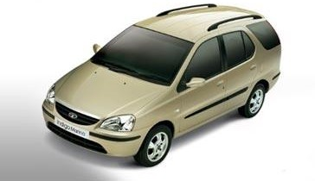
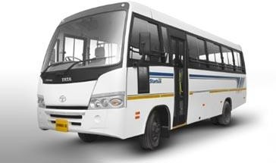
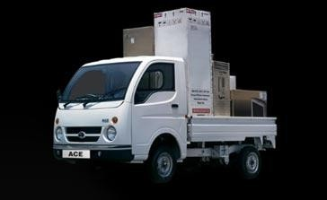
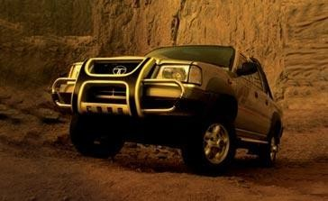
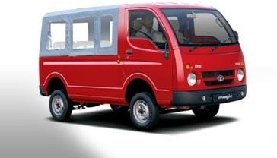
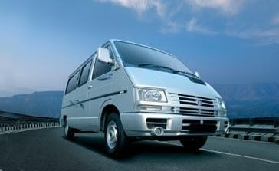
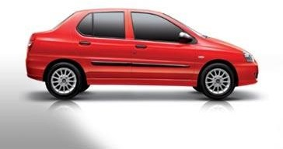
Tata Novus – 2004
Tata Indigo Marina - 2004
Globus – 2005
Tata ACE Mini Truck - 2005
Tata SUT Sports Utility Truck – 2007
Tata Magic - 2007
Tata Winger Maxi Van – 2007
Tata Indigo CS - 2008

Slide 15
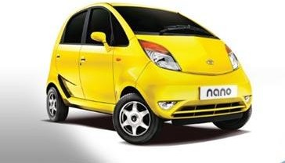
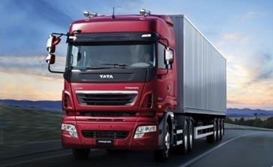
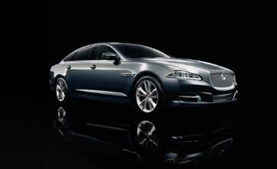
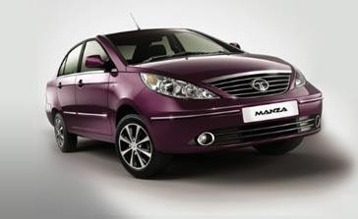
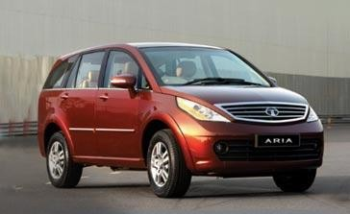
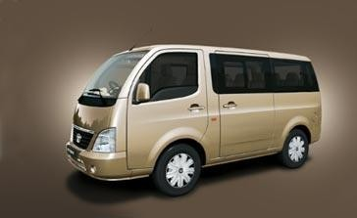
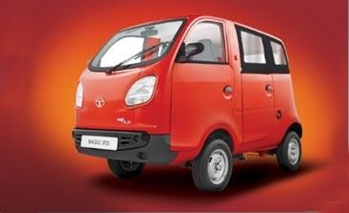
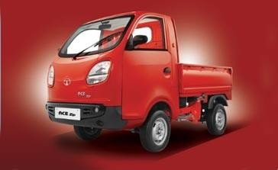
Tata Nano – 2009
Tata Prima Standard Truck - 2009
Jaguar Land Rover – 2009
Tata Manza - 2009
Tata Aria – 2010
Tata Venture - 2011
Tata Magic Iris – 2011
Tata Ace Zip - 2011

Slide 16
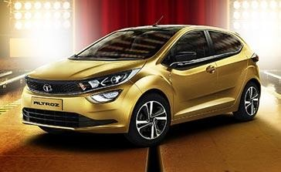
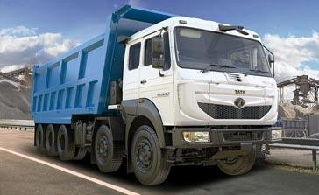
Tata Altroz – 2020
Tipper Truck Sigma - 2020

Slide 17
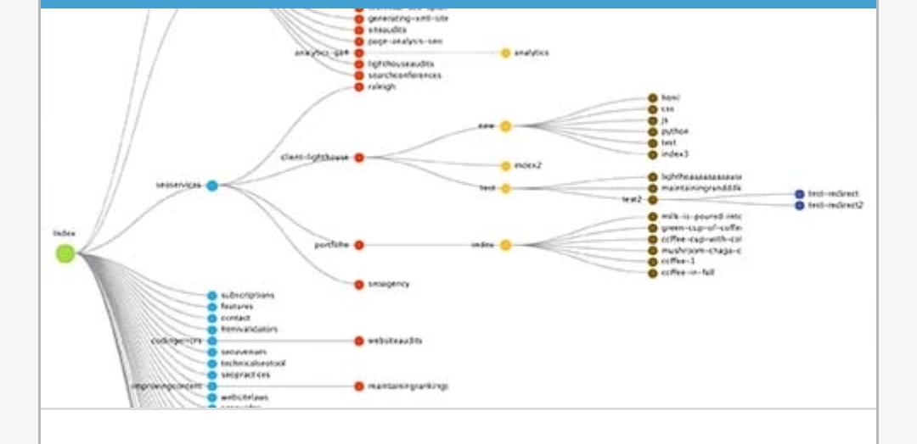
SEO Audit
Our Technical Spider Tool is a powerful website crawler that can help you discover issues and analyze the results in real time. You will be able to discover Technical SEO

Slide 18
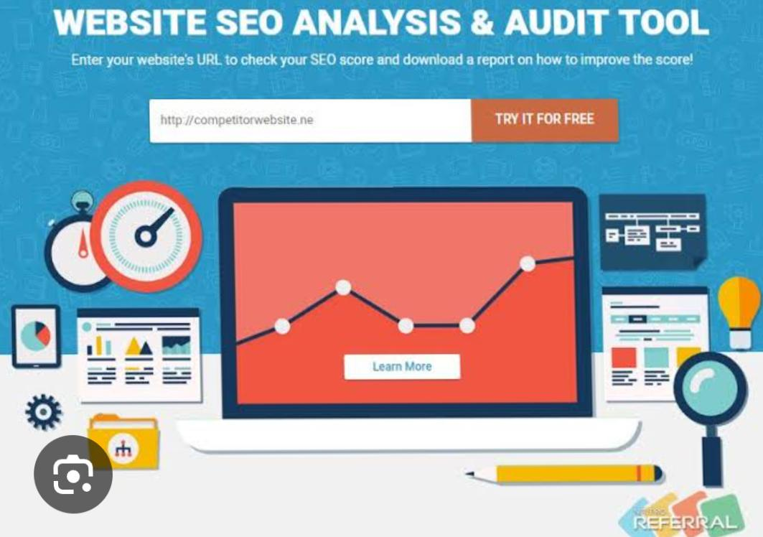
Keyword Research
TML’s focus is on strengthening market presence by offering solutions that meet and surpass customers’ expectations and deliver hassle-free sales and service experience to customers. JLR’s philosophy of ‘Customer First’ enables personalised and ‘easy to do with’ experience for its customers.

Slide 19
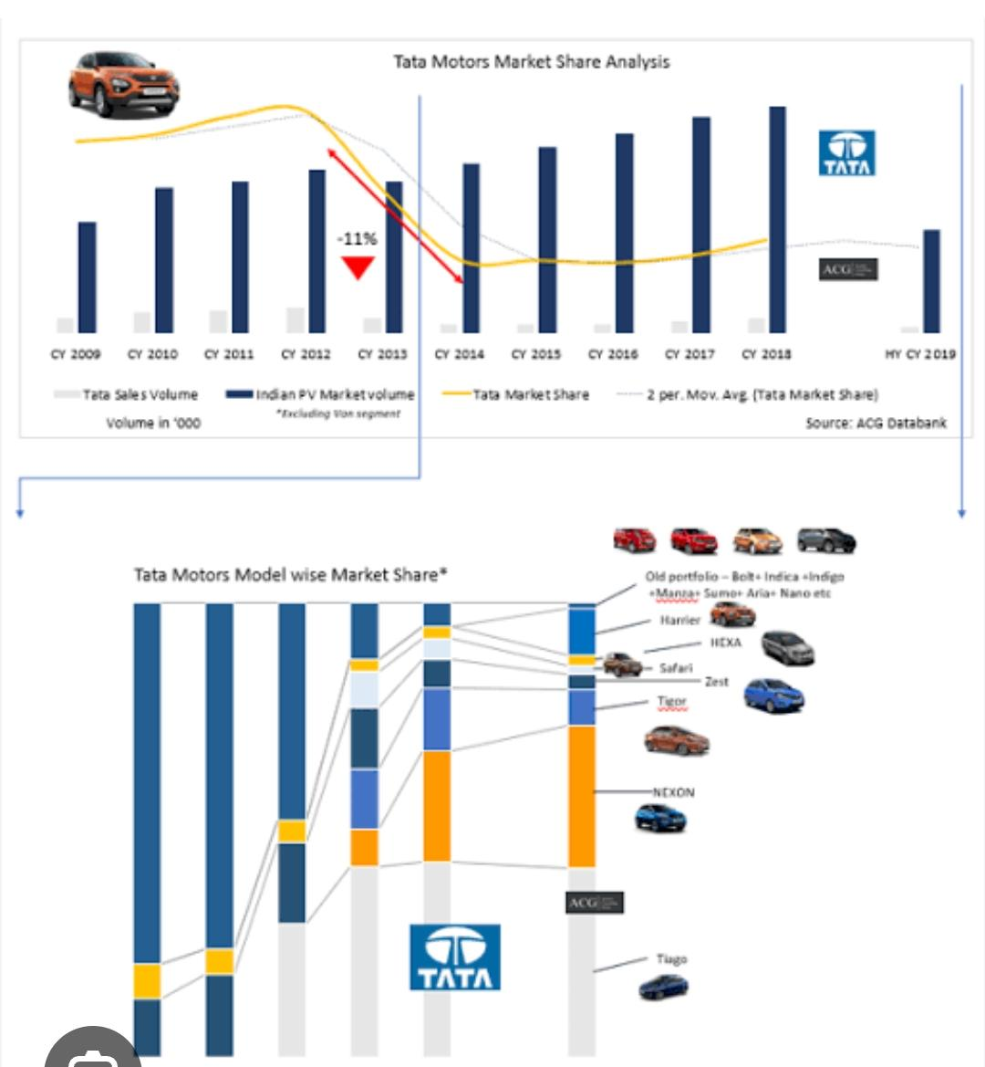
On Page SEO
Our comprehensive Technical SEO Spider tool is a fast, very effective way to analyze your site’s on-page SEO issues. Our web crawlers can be used on any device anywhere you are. When you conduct a website audit you will discover an overall view of every element of your site so you can improve your pages quickly with ease.

Slide 20
Part 3 Content Idea’s and Marketing Strategies
Content Marketing: Tata Motors creates engaging and informative content related to its products, such as videos, blog posts, and infographics. This helps to build brand awareness and establish their authority in the industry.
Tata Motors sells a wide range of vehicles, including passenger cars, trucks, buses, and defense vehicles. These vehicles are sold in over 170 countries worldwide, making Tata Motors one of the most globally diversified automotive companies.
This new identity is aligned to Tata Motors’ commitment on sustainability & pioneering innovation as well as Tata Group’s focus towards community development. The new brand identity embodies the core philosophy of “Move with Meaning,” unifying the values of sustainability, community, and technology.

Slide 21
Tata Motors is the world’s leading automobile manufacturing company. It is a part of Tata group. The company is one of India’s largest original equipment manufacturers (OEMs) providing wide range of integrated, smart and e-mobility solutions. The company was established in September 1945 by Jehangir Ratanji Dadabhoy Tata as Tata Engineering and Locomotive Company Ltd. It is headquartered in Mumbai, Maharashtra, India. Tata Motors’ diverse portfolio includes an extensive range of cars, sports utility vehicles, trucks, buses and defence vehicles. It has manufacturing, research and development and design facilities in over 25 sites across India, Europe, China, UK and North America. The company is present in more than 125 countries, with a worldwide network comprising of 9,000 touch points.

Slide 22
Trucks and Buses Defence
7 Products of TATA: Cars and Sports Utility Vehicles
Tata Motors was founded in 1945, as a locomotive manufacturer. Tata Group entered the commercial vehicle sector in 1954 after forming a joint venture with Daimler- Benz of Germany. After years of dominating the commercial vehicle market in India, Tata Motors entered the passenger vehicle market in 1991 by launching the Tata Sierra, a sport utility vehicle based on the Tata Mobile platform. Tata subsequently launched the Tata Estate (1992; a station wagon design based on the earlier Tata Mobile), the Tata Sumo (1994, a 5-door SUV) and the Tata Safari (1998).
Tata launched the Indica in 1998, a fully indigenous Indian passenger car tailor-made to suit Indian consumer needs though styled by I.D.E.A, Italy. Although initially criticised by auto analysts, its excellent fuel economy, powerful engine, and an aggressive marketing strategy made it one of the best-selling cars in the history of the Indian automobile industries. A newer version of the car, named Indica V2, was a major improvement over the previous version and quickly became a mass favourite. Tata Motors also successfully exported large numbers of the car to South Africa. The success of the Indica played a key role in the growth of Tata Motors.
In 2004, Tata Motors acquired Daewoo's South Korea-based truck manufacturing unit, Daewoo Commercial Vehicles Company, later renamed Tata Daewoo.
In 2005, Tata Motors acquired a 21% controlling stake in the Spanish bus and coach manufacturer Hispano Carrocera. Tata Motors continued its market area expansion

Slide 23
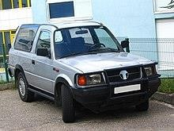

through the introduction of new products such as buses (Starbus and Globus, jointly developed with subsidiary Hispano Carrocera) and trucks (Novus, jointly developed with subsidiary Tata Daewoo).
In 2006, Tata formed a joint venture with the Brazil-based Marcopolo, Tata Marcopolo Bus, to manufacture fully built buses and coaches.
In 2008, Tata Motors acquired the English car maker Jaguar Land Rover, manufacturer of the Jaguar and Land Rover from Ford Motor Company.
In May 2009, Tata unveiled the Tata World Truck range jointly developed with Tata Daewoo; the range went on sale in South Korea, South Africa, the SAARC countries, and the Middle East at the end of 2009.
Tata acquired full ownership of Hispano Carrocera in 2009.
In 2013, Tata Motors announced it will sell in India, the first vehicle in the world to run on compressed air (engines designed by the French company MDI) and dubbed "Mini CAT".
In 2014, Tata Motors introduced first Truck Racing championship in India "T1 Prima Truck Racing Championship".
On 2 November 2015, Tata Motors announced Lionel Messi as global brand ambassador at New Delhi, to promote and endorse passenger vehicles globally.
On 8 March 2017, Tata Motors announced that it has signed a memorandum of understanding with Volkswagen to develop vehicles for India's domestic market.
Tata Motors Cars:
TATA SIERRA (1991-2000)
TATA SUMO (1994-2019)

Slide 24



TATA INDICA (FIRST GENERATION)
TATA BOLT
Jaguar Land Rover
Jaguar Land Rover
Jaguar Land Rover PLC is a British premium automaker headquartered in Whitley, Coventry, United Kingdom, and has been a wholly owned subsidiary of Tata Motors since June 2008, when it was acquired from Ford Motor Company of USA. Its principal activity is the development , manufacture and sale
of Jaguar luxury and sports cars and Land Rover premium four-wheel-drive vehicles.
Jaguar Land Rover has two design centres and three assembly plants in the United Kingdom. Under Tata ownership, Jaguar Land Rover has launched new vehicles including the Range Rover Evoque, Jaguar F-Type, the Jaguar XE, the Jaguar XJ (X351), the second-generation Range Rover Sport, and Jaguar XF, the fourth- generation Land Rover Discovery, Range Rover Velar and the Range Rover (L405).
Land Rover Discovery Sport JD Power, of the US, rates Land Rover and Jaguar as the two worse brands for initial quality. The Jaguar F-Pace made Consumer Reports February 2019 list of the 10 Least Reliable Cars. The editors cited "electronics, drive system, power equipment, noises and leaks" as problematic aspects.

Slide 25



The Jaguar Land Rover subsidiary was struggling by 2019 and Tata Motors wrote down its investment in JLR by $3.9 billion. Much
of the financial problem was due to a 50% drop in sales in China during 2019, although the situation was improving. Still, Tata was open to considering a partnership with another company according to a statement in mid-October, as long as the partnership agreement would allow Tata to maintain control of the business. The company ruled out the possibility of a sale of JLR to another entity.
Tata Nano
Tata Nano is often cited as the world's most affordable car. The Nano was launched in 2009 as a city car intended to appeal as an affordable alternative to the section of the Indian populace that is primarily the owner of motorcycles and has not bought their first car. Initially priced at ₹100,000 (US$1,500), the vehicle attracted a lot of attention for its relatively low price. However, the Nano was very poorly rated for safety and in 2018, Cyrus Mistry, chairman of the Tata Group, called the Tata Nano a failed project, with production ending in May 2018.
Tata Prima
Tata Prima is a range of heavy trucks first
introduced in 2008 as the company's 'global' truck. Tata Prima was the winner of the 'Commercial Vehicle of the Year' at the Apollo Commercial Vehicles Awards, 2010 and 2012.

Slide 26

Tata Harrier
Tata Harrier is a 5-seater SUV set to rival the
Hyundai Creta and Jeep Compass. This car uses the engine from Fiat and transmission from Hyundai. It is derived from the H5X Concept displayed at the 2018 Auto Expo. It was launched on 23 January 2019. The car is a C-segment crossover SUV based on the Omega Arc platform, an essentially re-engineered version of the Jaguar Land Rover D8 platform. A petrol variant of the Harrier is confirmed to launch in 2021.
Tata Ace
Tata Ace, India's first indigenously developed sub-one-ton minitruck, was launched in May 2005. The minitruck was a huge success in India with auto analysts claiming that Ace had changed the dynamics of the light commercial vehicle (LCV) market in the country by creating a new market segment termed the small commercial vehicle segment. Ace rapidly emerged as the first choice for transporters and single truck owners for city and rural transport.
By October 2005, LCV sales of Tata Motors had grown by 36.6% to 28,537 units due to the rising demand for Ace. The Ace was built with a load body produced by Autoline Industries.
Tata Motors in Defence:
With a wide range of products operating across the entire military spectrum – from
Logistics to front-line Combat, Tata Motors today is the largest private sector mobility player in the Defence space in India. Our mobility solutions portfolio has grown from strength to strength to include all classes of vehicles - from light to heavy and across the entire Defence, Paramilitary and Police mobility segment.
Tata Motors has supplied over 100,000+ vehicles to various Paramilitary & State Police forces and is the only OEM having the widest range of vehicles available in over
10 DGS&D Rate Contracts. Tata Motors is proud of its association with the Paramilitary & Police forces and keeps continually improving & innovating products that cater to the forces specific mission requirements.

Slide 27
In addition to being a leading supplier of mobility solutions to the Indian Army, Navy, Air Force and various Paramilitary forces, the company also exports its range of specialized Defence vehicles to SAARC, ASEAN, African nations and the UN peacekeeping forces in conflict zones in Africa.
2.8 Organisation Structure:
Every organization has its own typical management structure that defines and governs the relationships between the various employees, the tasks that they perform, and the roles, responsibilities and authority provided to carry out different tasks.
An organization that is well structured achieves effective coordination, as the structure delineates formal communication channels, and describes how separate actions of individuals are linked together.
Organizational structure defines the manner in which the roles, power, authority, and responsibilities are assigned and governed, and depicts how information flows between the different levels of hierarchy in an organization.
An organizational chart is the visual representation of this vertical structure. It is therefore very important for an organization to take utmost care while creating the organizational structure. The structure should clearly determine the reporting relationships and the flow of authority as this will support good communication – resulting in efficient and effective work process flow.

Slide 28


Slide 29
Shareholders: A shareholder, also referred to as a stockholder, is a person, company, or institution that owns at least one share of a company's stock, which is known as equity. Because shareholders are essentially owners in a company, they reap the benefits of a business' success.
Board of Directors: A board of directors is essentially a panel of people who are elected to represent shareholders. The board is responsible for protecting shareholders' interests, establishing policies for management, oversight of the corporation.
A chief executive officer (CEO): He is the highest-ranking executive in a company, whose primary responsibilities include making major corporate decisions, managing the overall operations and resources of a company, acting as the main point of communication between the board of directors (the board)
Managing Director: The person who is in overall charge of the running of an organization or business. He is the managing director of an engineering firm".
Audit Committee: An audit committee is one of the major operating committees of a company's board of directors that is in charge of overseeing financial reporting and disclosure.
Nomination Committee: A nomination committee evaluates a firm's board of directors and examines the skills and characteristics required of board candidates.
Investor Grievances Cell: Redressal of investor grievances is one of the key components of SEBI's efforts to protect the interests of investors in securities. There will be occasions when an investor has a complaint against, a listed company or an intermediary registered with SEBI.
Ethics and Compliance: Hold employees accountable By clearly defining the company's mission, values, and goals – and developing policies such as a written code of conduct to reflect the mission, values, and goals – you are creating an ethical compliance culture.
Legal Head: The Head of Legal is tasked with analyzing and identifying the legal risks and implications of all of the business's transactions, keeping the senior management in all departments of the business informed of developments in laws and regulations that potentially affect the business.

Slide 30
Company Secretary: The company secretary is responsible for the efficient administration of a company, particularly with regard to ensuring compliance with statutory and regulatory requirements and for ensuring that decisions of the board of directors are implemented.
Corporate Planning: is the act of creating a long-term plan to improve your business. A corporate plan examines a business's internal capabilities and lays out strategies for how to use those capabilities to improve the company and meet goals.

Slide 31
1 Functional Areas of Tata Motors:
Engineering and Design
Research and Development
Production Department
Logistics
IT Services
Human Resource Department
Finance Department
Tata Motors
Engineering and Design
Reaserach and Development
Production Deapartment
Logistics
Human Resource Department
Finance Department
There are few main departments in Tata Motors:
Engineering and Design:
This department is focus on the engineering design process in any of the various engineering disciplines. Design engineers tend to work on products and systems that involve adapting and using complex scientific and mathematical techniques.
Research and Development Department: Research and development (R&D)
includes activities that companies undertake to innovate and introduce new products and services. It is often the first stage in the development process. The goal is typically to take new products and services to market
Production Department: A production department is a group of functions
within a business that is responsible for the manufacture of goods. The production department can be the largest organization within a business. It may employee mechanics, machine setup specialists, maintenance personnel, and machine operators.

Slide 32


Logistics: Logistics management is that part of the supply chain which plans, implements and controls the efficient, effective forward and reverse flow and storage of goods, services and related information between the point of origin and the point of consumption in order to meet customers' requirements.
HR Department: HR (Human Resources) department is a group who is responsible for managing the employee life cycle (i.e., recruiting, hiring, onboarding, training, and firing employees) and administering employee benefits.
Finance Department: Finance Department is the part of an organization that is
responsible for acquiring funds for the firm, managing funds within the organization.
3.2 Awards and Achievements:
“DigiVOR” received three awards in rapid succession – TML Innovista Award, Golden Peacock Award and World Innovation Congress Award. It also made it to the final round of the Tata Group Innovista competition
Tata teams won 2 silver and 3 bronze awards, the 1st position by winning the Platinum Award in the OEM category at CII’s Digitalisation, Robotics & Automation Industry 4.0

Slide 33





Jamshedpur and Dharwad teams won the Bronze Trophy in the OEM Category at the Confederation of
Indian Industry Competition on
National Digitalisation,
Robotics and Automation – Industry 4.0.
The Jamshedpur team won 2 awards under Operational and Production &
1 award under the Repairing and
Maintenance category at 20th CII National Supervisory Skill Competition
Engineering Research Centre, Pune won the Golden Peacock Eco- Innovation Award 2020 for Enhanced TCO School Bus. The winning model is the Best-in-class Fuel Economy, Improved NVH – Cost of Ownership – Safety.
Sanand Plant won the Golden
Peacock Environment and Management Award 2020 for their efforts in sustainability and environment management
Jamshedpur Plant was recognised as ‘The Super Shopfloor of the Year’. Both Dharwad & Sanand Plant won ‘Excellence in Covid-19 Innovation’ award, and Pune CVBU won the ‘Machining Excellence’ Award

Slide 34
3.3 Contact Details:
Head Office:
Tata Motors Limited,
Passenger Vehicle Business Unit, 4th Floor, Ahura Centre,
82 Mahakali Caves Road,MIDC, Andheri - ( East ). Mumbai - 400 093.
022-62407101 / 09
Registered Office:
Bombay House, 24,
Homi Mody Street, Fort, Mumbai 400001. Phone :+91-22-66658282.
customercare@tatamotors.com
3.4 Corporate Social Responsibility:
Global automobile manufacturer Tata Motors Limited acknowledges its roots and tirelessly works to address the needs and aspirations of the community, pushing others onwards to development. They have a six-pronged CSR strategy that attends to the societal needs starting from pre-natal care to education, and serves across the spectrum – helping with high-school level courses to professional ones, leading to employability and employment.
Furthering our Sustainable Development Goals (SDGs), our corporate social responsibility initiatives in FY 2019-20 touched 830300 lives, of which 41% belong to

Slide 35

the SC and ST communities. We have been catering to domains, starting with sustainability initiatives through community engagement, to social upliftment and environmental transformation, addressing healthcare and sanitation issues, strengthening household income, making women self-reliant and more.
Aarogya - Addressing malnutrition, spreading awareness and delivering preventative healthcare – Impacted 3,99,619 lives
Kaushalya - Improving employability through skill development, vocational
training, assistance for supplementing income, women empowerment – Skilled 1,17,474 people
Amrutdhara - Offering water relief measures – Impacted 21,666 lives
Seva - Tata Motors’ family volunteered – 1,11,960 hours for social upliftment
Vidyadhanam - Holistic educational initiatives and financial support – Touched lives of 1,52,558 students
Vasundhara - Planted 1,17,464 saplings, and reached out to create awareness in 91,025 people
Aadhaar - Rural focussed programmes for integrated development approach – Committed to better lives of 3000 tribal communities
Besides the ongoing programmes for societal and community betterment, Tata teams respond to issues on ‘need’ basis across the year as well. In FY 2019-20, they reached out to impact 45000 lives under Maharashtra Flood Response Programme; and also supplied relief to 13199 communities across plant locations, which were turned vulnerable due to the COVID 19 pandemic.
Tata Motors is committed to sustainable development, where business goes hand in hand with societal wellbeing and environmental consciousness.

Slide 36


Aarogya - Health:
Good health is cardinal to human wellbeing and enables one to achieve life goals.
Aarogya, health initiative, focuses on overall well-being of both, urban and rural communities.
Tata initiatives try to address malnutrition in children who are between 0-6 years of age. Apart from providing supplementary diet and nutritional supplements to malnourished children, the focus has been to work on preventive measures like enabling behavioural changes in communities,
especially the young mothers and parents, through awareness sessions.
Added to these interventions are the curative health care services where in the communities are serviced through diagnosis, administration of generic medicines and consultations. Access to safe drinking water is another concern that they initiative Amrutdhara aims to address.
Tata health program has benefitted 3,99,619 people. Over 74% of the malnourished
children are in healthy category and there has been positive change in the knowledge, attitude and the behaviour of the communities on health. Infusing sustainability is core to our approach; therefore, we strengthen institutional delivery mechanism by enhancing the capacities of the personnel from the government on one hand while mentoring communities to take ownership of programmes on the other.
Vidyadhanam – Education:
Education aids the development of an individual’s cognitive, psychological and intellectual faculties that ultimately shapes his or her personality.
Vidyadhanam, education initiative, addresses the needs in the entire spectrum of education, starting from middle school to higher learning.
TML has adopted a targeted approach for improving the scholastic performance and

Slide 37

infusing confidence in children, which includes:
Instituting need based rolling scholarships/ financial supports for financially challenged students
Organizing support classes for difficult subjects for high school students
Value based life skills, sports and other co-curricular activities
Plugging gaps in infrastructure at schools
A conscious effort has been made to target the middle school level which has a dearth
of resource and a significant representation of SC/ST communities, and a maximum school drop-out rate which is close to 50%. Nearly all of our Education interventions have been digitized.
3. Kaushalya - Employability or Skilling:
Our Employability (Skill Development) program focusses on training school drop- outs and unemployed youth in auto trades, non-auto trades and agriculture & allied activities, and also helps with institutional strengthening.
As an approach, Kaushalya reaches out to the huge pool of school dropout unemployed youth. The courses are available for youths from our corporate social responsibility education programs, for those who have a dire need to support their families or don’t wish to continue education. Given the limited opportunity to productively participate in the formal economy, our skill development programme in India “accelerate aspirations” of school dropout youth, in sectors which provide opportunity to those who undergo continuous formal learning and training (ITI and Diploma).
Auto Trade: Tata Motors leverages its domain knowledge automobile space and has
designed courses (like auto service technician) which have been approved by Automotive Skill Development Council (ASDC). We leverage our dense network of Industrial Training Institutes for imparting training and over 6600 Dealers and Tata Authorized Service Stations (TASS) for On-the-Job Training (with commitment of spend).

Slide 38
Non-Auto Trade: Tata Motors offers a host of vocational training courses which have high market demand.
Agriculture and Allied Activities: Tata Motors Limited caters to the need of communities which fall beyond the 50-kilometre radius from the plant facilities (Jamshedpur, Pune, Palghar and Thane). The emphasis is on infusing new technology, better agricultural practices, livelihood programmes, animal rearing etc.
Institutional Strengthening: Tata Motors regularly introduces and administers
courses for the instructors and leadership of the training institutes (ITI and Polytechnic Colleges) and NGO partners. The modules range from technical, functional to soft skills. The company also bridges the resource gap by offering support through donation of equipment, revisions and by upgrading courses.
Vasundhara – Environment:
Through Vasundhara initiatives, our work on environment, we are making
concentrated efforts to increase the green cover through sapling plantation on one hand and enhancing the environmental awareness levels in the community on the other hand.
Tata Motors, under its environment related CSR – Vasundhara programme, makes concentrated efforts to increase the green cover.
TML has planted 1,24,548 saplings (of indigenous varieties) across locations and
ensured their survival rate is significantly high (85%). At few locations, these places have turned into microhabitats which host varied species of flora and fauna. Our environmental awareness programmes aim to sensitise young children, and we have been able to reach to 91,025 persons, making these one of the dynamic green initiatives by corporates in India.
Amrutdhara - Drinking Water:
Tata Motors, as a part of its Amrutdhara programme, has been attempting to make clean and safe drinking water accessible to water stressed habitations across India. Amrutdhara is a National Drinking Water Project initiated by Tata Motors. Government records show that in 1980, just 1% of India’s rural areas had access to safe, usable water. By 2013, that had increased to 30%, but the majority of rural India continues to live without proper access to safe drinking water. Less than 50 per cent of the population in India has access to safely managed drinking water.

Slide 39

Moreover, two-thirds of India’s 718 districts are affected by extreme water depletion.
WaterAid report in 2016 ranked India among the worst countries in the world for the number of people without safe water. An estimated 76 million people in India have no access to a safe water supply. The Asian Development Bank has forecast that by 2030, India will have a water deficit of 50 per cent. It is estimated that waterborne diseases have an economic burden of approximately USD 600 million a year in India.
Responding to such situation, Tata Motors through its company floated NGO,
Sumant Moolgaokar Development Foundation (SMDF) launched ‘Amrutdhara’ – the National Drinking Water Programme in 2010. The objective of Amrutdhara is to provide sustainable drinking water solution to water stressed parts of the country. These solutions rely heavily on the traditional water conservation and management practices of the communities and range from infiltration wells or ‘nullah’ system in the hills to capturing water trapped in the aquifers or having big water reservoirs.
6. Aadhaar - Tata Affirmative Action Programme:
Tata Motors believes that inclusive, equitable and holistic development of society is essential for nation building as for sustainable growth of the organization. Tata Motors believes in creating an inclusive society and has instituted Affirmative Action (AA) under the brand called Aadhaar. Tata Motors Affirmative Action (AA) programme, Aadhaar, is aimed at serving traditionally disadvantaged communities, such as Scheduled Castes (SC) and Scheduled Tribes (ST), with a focus on the 4E’s – Education, Employability, Entrepreneurship and Employment.
Aadhaar has been integrated with our CSR programme for improved efficiency and
better reach. In addition to deploying forty percent of the CSR budget for the AA programme, we have developed synergetic inter-linkage among the AA focus areas. In lined with our philosophy of ‘More from less for More’, we have partnered with various state governments for skill development of SC/ST youth in automotive

Slide 40

Report on Tata Motors
trades. Our dealers have been strategically involved with the LEAP programme which aims at training underprivileged youth as motor mechanics. The dealers pay stipend to the trainees as well as employ them once the training is successfully completed. Tata Motors has also tied up with project implementation partners to mobilise government schemes specifically designed to train youth in automotive trades.
In partnership with our group company Tata Communications, we are promoting
higher education and have partnered with the IIT Bombay Alumni Association to establish a revolving fund for underprivileged engineering students. Apart from receiving financial support, these students are mentored by senior leaders of the two companies. Along similar lines, we have also established the Tata Samarth scholarship for students of institutes affiliated with the College of Engineering, Pune.
7. Seva – Volunteering:
Going beyond investing their
personal time through volunteering, senior leadership has institutionalised a culture by creating a volunteering policy.
Envisioning development for all, Tata Motors encourages their associates and workforce to volunteer
time for social causes. As a part of Seva, our Employee Volunteering Policy, we enable our employees to
invest minimum 8 hours of company time towards social issues. Family members of our employees and superannuated colleagues are also encouraged to voluntarily work for social development. Nearly 53% of our colleagues (14738 employees) volunteered and invested over 1.1 lakhs volunteering hours during FY 2019-20. Tata Motors employees also offer pro-bono skill-based, professional services to voluntary organisations under Tata Group-wide ‘Pro Engage’ format that lasts for 6 months duration. About 178 managers invested nearly 10000 volunteering hours towards strengthening institutions.

Slide 41
SWOT Analysis:
SWOT analysis of Tata Motors analyses the brand/company with its strengths, weaknesses, opportunities & threats. In Tata Motors SWOT Analysis, the strengths and weaknesses are the internal factors whereas opportunities and threats are the external factors.
SWOT Analysis is a proven management framework which enables a brand like Tata Motors to benchmark its business & performance as compared to the competitors and industry.
Strengths:
Tata Motors is one of the most established company in automobile sector in India
Tata Motors has a wide & extensive distribution and service network
Good market penetration in the taxi & rental segment
Expert service professionals available
Many associations like Jaguar Land Rover, Hispanso, Macropolo etc increases Tata Motors' international presence
Dedicated engineering and R&D department
More than 70,000 employees are present with Tata Motors
Highly diversified product portfolio
Strong brand legacy owing to parent brand Tata
Weakness:
Limited international presence as compared to international car manufacturers
Controversies like Singur plant for Nano etc hurt Tata Motors
Opportunities:
Expanding automobile market can be a boon for Tata Motors
Increasing per capita income and purchasing capability of potential customer base
Leveraging customer engagement experience to acquire new customers can be done by Tata Motors
Leveraging mergers and acquisitions to acquire newer technology

Slide 42




Tata Motors can boost business by augmenting the distribution and service network in various countries
Threats:
Increasing fuel costs
Competition from other big automobile giants means reduced market share for Tata Motors
Competitive products offering same level features at a lesser price
Product innovations and frugal engineering by competitors
3.6 Tata Motors Quality Policy:
Quality Policy:
Tata Motors Hospital is committed to maximizing customer satisfaction. It strives to achieve the goal of excellence by continual improvement through reliable, safe, cost- effective quality diagnosis. By using environmentally sustainable processes, the treatment in this Hospital is one of the best among all other industrial hospitals in the country. Tata Motors Hospital is committed towards improving the quality of life of its employees through improved work practices and facilities.
3.7 Tata Motors Safety, Health, Education and Environmental Policy:
Safety Policy
Tata Motors Hospital is fully committed to be an injury-free organization and safeguarding the occupational health of its direct and indirect employees at work. The Company firmly believes that safety is an integral part of its operation and all levels of

Slide 43
management have prime responsibility towards safety. The company also firmly believes in proactive measures preventing occupational illness. In achieving these objectives, Tata Motors will involve its employees and allocate adequate resources for continuous improvement in its occupational health and safety performance.
Tata Motors Health and Safety Policy: The Tata Group is committed to providing a safe and healthy working environment and achieving an injury- and illness-free work place.
Economic considerations will not have priority over implementation of safety and health protection measures. While safety is everyone’s prime responsibility, senior leaders are expected to demonstrate visible commitment through their behaviour. To meet the commitment, they will;
Recognise safety and health as an integral part of their operations; consider
Safety and Health in every decision they make and in every activity they perform.
Comply and endeavour to exceed applicable regulatory safety and health requirements and set the highest standards.
Impart appropriate training and develop skills by engaging employees to help them work safely.
Assess risks and provide controls for safety and health hazards in their operations and activities and use audits to check compliance.
Promptly report incidents, investigate for root causes and ensure lessons learnt are shared and deployed across the group companies.
Influence our business partners in enhancing their safety and health standards.
Set safety and health metrics as indicators of excellence, monitor progress and continually improve performance.
They aspire to become world leaders and be a benchmark in safety and health
performance in our respective business sectors. The key is in internalisation of safety and engagement with our employees.

Slide 44
Tata Motors Education Policy:
Education
Through our history, they have championed initiatives to ensure access to quality education for all, while building some of India's finest institutions
“What advances a nation or a community is not so much to prop up its weakest and most helpless members, but to lift up the best and the most gifted, so as to make them of the greatest service to the country." Jamsetji Tata
The Tata group continues to be inspired by this vision of our Founder—that nation- building must begin with the educational upliftment of its people. Whether it is through our establishing of great institutes of learning, or the scope of Tata companies' programmes to make education accessible to the most marginalised communities, they are committed to the idea of universal education.
Tata Motors Environment Policy:
Environment:
They know that businesses can play a major role in protecting our planet. That is why Tata group companies actively endeavour to conserve at-risk species, and safeguard shrinking habitats and fragile ecosystems
Tata group companies are strongly driven by international benchmarks for sustainable practices in business. But a greater portion of what the group does in this sphere is by choice and conviction. From this flows its support for endeavours to conserve plant and animal species, improve land and water use, and protect forest tracts and green sanctuaries.
The group's contribution to conservation falls into two categories: the efforts of different Tata companies, big and small, to preserve and enrich the environment in and around their areas of operation, and the philanthropic thrust of the Tata Trusts, which support a diverse cluster of non-governmental organisations working in areas such as the management of natural resources, community development and livelihoods.

Slide 45
Conclusion:
Tata motors is market leader in automobile industry. Tata motors is well known Indian brand known for its quality, reliability and safety of its vehicles. Tata motors is also known for its good reason by providing financial help to NGO’s, trusts, educational institute and monetary help to needy students by providing scholarship. Tata has its best practices, ethical standards, environmental policies, safety and social measures to its employees, and also for its societal members. After all the research work, I come to a conclusion that Tata has a wide range of products and services to its customer every year. It is coming with innovation in their products. Through SWOT analysis it is concluded that Tata Motors have more strengths in terms of employees, research and development that helps in satisfying customer expectations.
Through our analysis of Tata Motors, we have evaluated that Tata Motors has been evolving throughout the years. By being more efficient with their products, they have a possibility of increasing their market share compare to its competitors.

Slide 46


